Slide 1
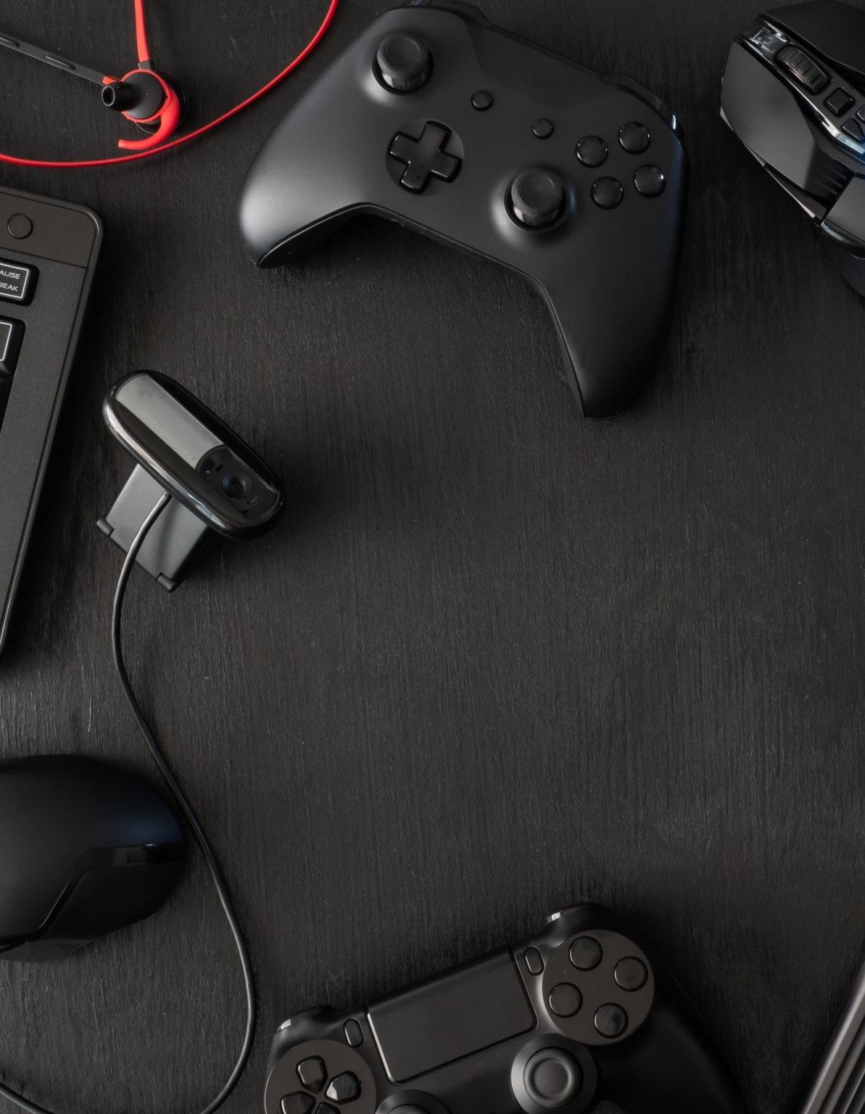
Hyper-Personalized In-Game Advertising
Revolutionizing Advertising in the Gaming World; Bibas Rai, Deep Wilson, Kartik Gehlot, Deepak Singh

Slide 2

Problem Statement
Current ads intrusive and generic;
Poor user experience;
Low engagement rates

Slide 3




Solution Overview
Hyper-personalized ads within video games: Ads matched to user interests, seamlessly integrated

Slide 4

Market Opportunity
Size of gaming industry
Advertising spend trends
Demand for personalised advertising

Slide 5

Technology Implementation
Use of VectorDB for matching Ads to users
Dynamic ad insertion technology
Data privacy and user consent mechanisms
MongoDB, GenAI (text to image, music), segmentation using Grounding DINO + SAM,
Computer vision techniques (matting, contour detection)

Slide 6

Benefits & Features
Improved user experience
Higher engagement rates for advertisers
New revenue streams for developers

Slide 7

Challenges & Solutions
User privacy concerns; Integration with diverse game environments; Partnership with developers

Slide 8

Business Model
Revenue sharing with developers; Pricing model for advertisers

Slide 9

Market Strategy
Targeting indie and AAA developers; Partnerships with ad networks; Early adopter incentives

Slide 10

Closing & Call to Action
The future of in-game advertising; Invitation for collaboration. https://github.com/bibasrairockz/Hyper-Personalized-In-Game-Advertising.git Thank you!

